Slide 1
Šetnja zagrebačkim parkovima
Goran Mačkala, 5.a

Slide 2
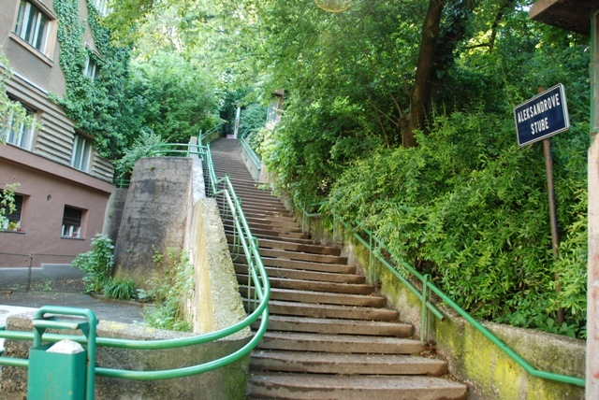
Aleksander’s stairs
Aleksander’s stairs connect the Rokov park with Tuškanec.
Stairs were named after Šandor Aleksander – a trader and humanitarian during the First World War.

Slide 3
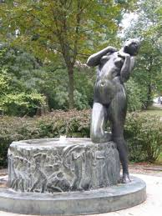
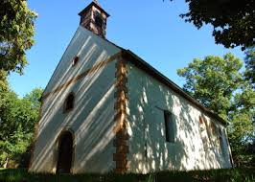
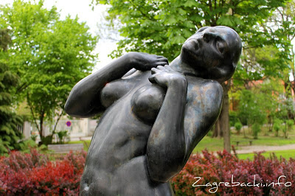
Roko’s park
Fountain Elegija
Saint Roko’s chapel
Roko’s park is a hill connecting Gradec and Kaptol.
This beautiful park was once a city and cemetery.

Slide 4
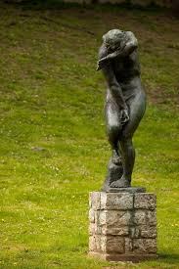
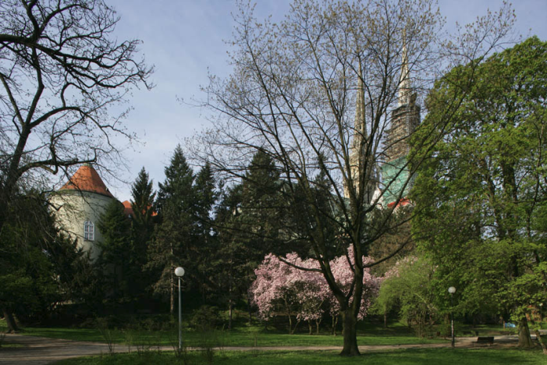
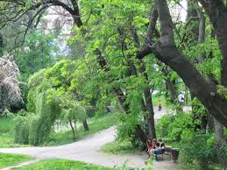
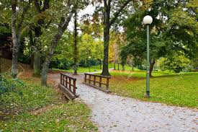
RIBNJAK
The park was named after the fishponds in the area.
The park is located five minutes of walk away from the Main Square.

Slide 5
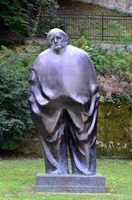
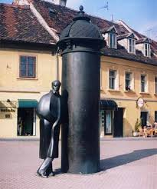
Statues of Krleža and Šenoa – famous Croatian writers
Miroslav Krleža was the greatest Croatian writer of the 20th century.
Statue is a work of the academic sculptor Marija Ujević Galetović.
Statue is placed near the house where Krleža lived.
August Šenoa was one of the most popular Croatian novelists in the 19th century.
Statue is a work of the academic sculptor Marija Ujević Galetović.
Statue is placed at the intersection of Vlaška and Palmotićeva Streets.

Slide 6
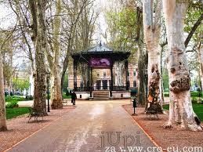
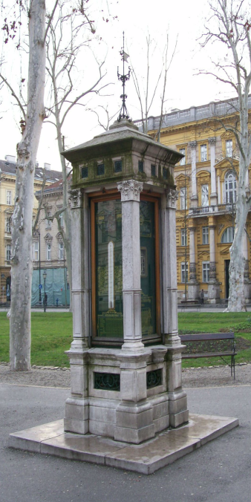
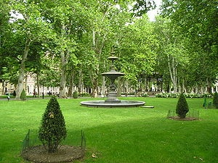
Zrinjevac
Nikola Šubić Zrinski Square, popularly referred to as Zrinjevac, is a square and park in Donji Grad, the central part of Zagreb.
In the middle of the park there is a music pavilion built in the 19th century.
In the southern part of Zrinjevac there are busts of significant Croatians (e.g. Frankopan, Mažuranić).

Slide 7
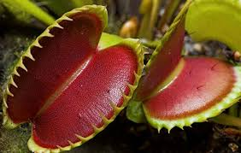
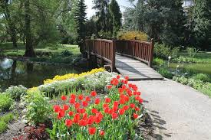
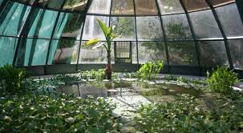
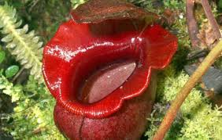
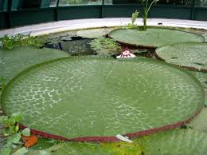
Botanic garden
Bridge
Carnivorous plants
Hot house
The Zagreb Botanical Garden is located in downtown.
It is home to over 10,000 plant species from around the world, including 1,800 exotic ones (e.g. carnivorous plants).
It has large ponds for aquatic plants.
Water lilies

Slide 8
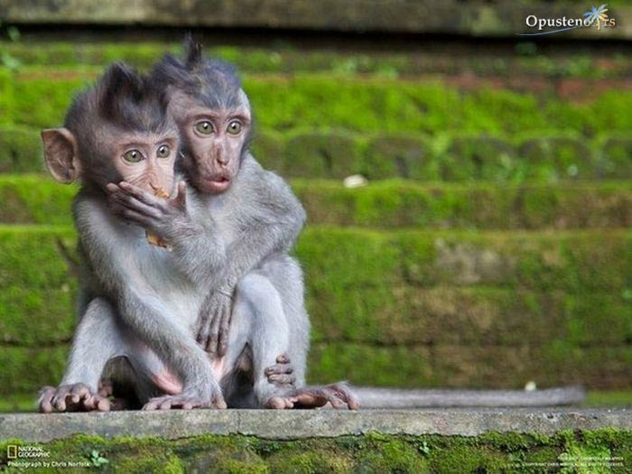
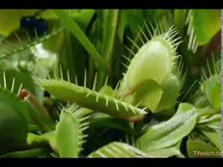
THANKS FOR ATTENTION

